Slide 1
UTS KALKULUS
Galih Anggoro Prasetya 22205018 Teknik Informatika
+
3-1

Slide 2
+
UTS Kalkulus

Slide 3
SOAL LIMIT TRIGONOMETRI

Slide 4


1.
2.

Slide 5
Jawaban Limit Trigonometri

Slide 6
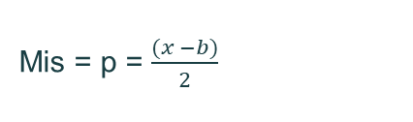
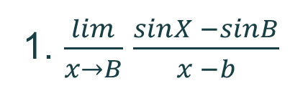
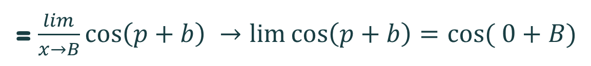
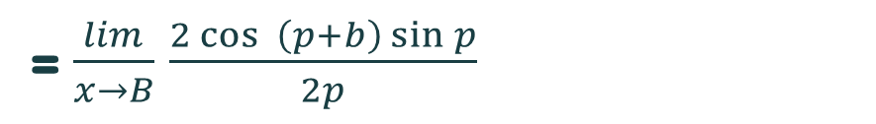
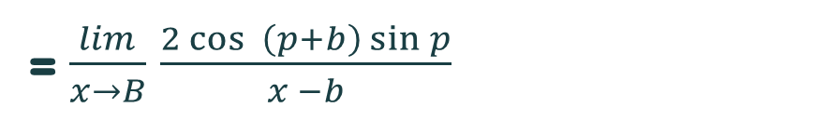
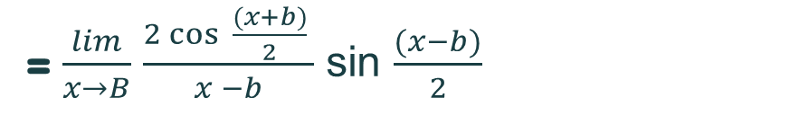
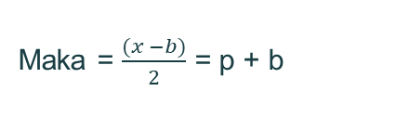
1. $\frac{lim}{x→B}$ $\frac{sinX −sinB}{x −b}$
Mis = p = $\frac{(x −b)}{2}$
= $\frac{lim}{x→B}$ $\frac{2\cos{ \frac{(x+b)}{2} }}{x −b}$ sin $\frac{(x−b)}{2}$
Maka = $\frac{(x −b)}{2}$ = p + b
= $\frac{lim}{x→B}$ $\frac{2\cos{ \left(p+b\right)\sin{p}}}{x −b}$
Maka = x – b = 2p
= $\frac{lim}{x→B}$ $\frac{2\cos{ \left(p+b\right)\sin{p}}}{2p}$
= $\frac{lim}{x→B}\cos\left(p+b\right) →lim⁡\cos\left(p+b\right)=\cos{( 0+B)}$
P ->0
= cos B

Slide 7
2. $\frac{lim}{x →0}$ = $\frac{−\sin\left(x+a\right)+sin⁡(x−a)}{1}$
$\frac{lim}{x →0}$ = $\frac{−\sin\left(x+a\right)+sin⁡(x−a)}{1}$
- Sin (0 + a) + sin (0 - a) = - 2 sin (a)

Slide 8
SOAL TRIGONOMETRI

Slide 9
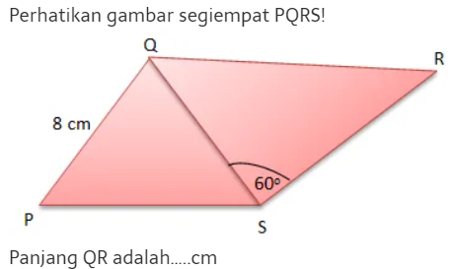
1.
2.

Slide 10
Jawaban Trigonometri

Slide 11
1 + 1 + 2 sin x cos y + 2 sin y cos x = 13 / 4
1.
2 + 2 sinx cos y + 2 sin y cos x = 13 / 4
2 sinx cos y + 2 sin y cos x = 13 / 4 - 2
2 (sinx cos y + 2 sin y cos x) = 5 / 4
Sin x cos y + sin y cos x = 5 / 8 -> sin y cos b + cos x sin b = sin(2+b)
Sin (x + y) = 5 / 8

Slide 12



$∆$pqr
2.
As² = pq2 – 2pq cos p
8² + (8$\sqrt{2}$)² – 2 (8)(8$\sqrt{2}$) cos 45
= 64 + 128 – 16 (8$\sqrt{2 \left(\frac{2}{2}\right)}$
QS =$\sqrt{64}$ = 8
$\frac{QS}{\sin{R}}$ = $\frac{QB}{\sin{S}}$
$\frac{8}{\sin{30}}$ = $\frac{QR}{\sin{60}}$
$\frac{8}{1/2}$ = $\frac{QR}{\frac{1}{2\sqrt{64}}jadi QR 8\sqrt{8}}$

Slide 13
SOAL PERTAKSAMAAN

Slide 14
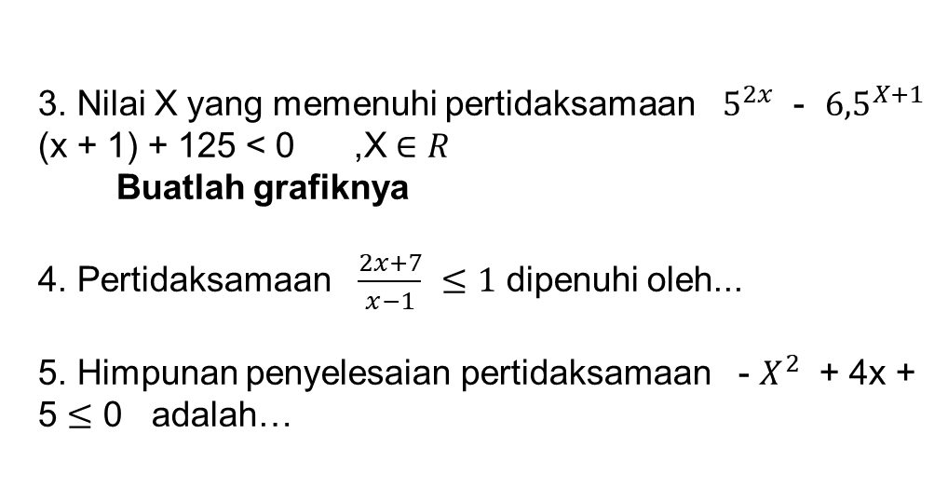
3. Nilai X yang memenuhi pertidaksamaan $5^{2x}$ - ${6,5}^{X+1}$ (x + 1) + 125 < 0 ,X $∈R$
Buatlah grafiknya
4. Pertidaksamaan $\frac{2x+7}{x−1}$ $≤1$ dipenuhi oleh...
5. Himpunan penyelesaian pertidaksamaan - $X^{2}$ + 4x + 5 $≤$ 0 adalah…

Slide 15
JAWABAN PERTAKSAMAAN

Slide 16

HP= {1 < x < 2} Jawaban = A
3. $5^{2X} − {6,5}^{X+1}$ + 125 < 0
$5^{2X}$ - ${6,5}^{X}$. $5^{1}$ + 125 < 0
$5^{2X}$ - ${30.5}^{X}$ + 125 < 0
Misal $5^{x}=p,maka:$
$p^{2}$ - 30p + 125 =0
(p-25) (p-5) = 5
Untuk p = 25, maka nilai x :
$5^{x}=25$
x = 1
Untuk p = 5, maka nilai x:
$5^{x}$ = 5
x = 1
+ +
-
1 2

Slide 17
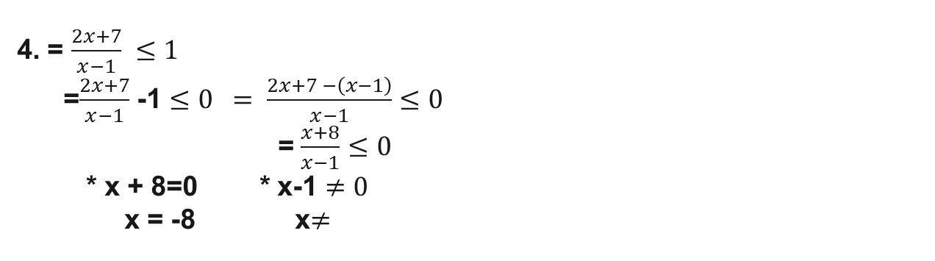

4. = $\frac{2x+7}{x−1} ≤1$ =$\frac{2x+7}{x−1}$ -1 $≤0 = \frac{2x+7 −\left(x−1\right)}{x−1}≤0$ = $\frac{x+8}{x−1}$ $≤0$ * x + 8=0 * x-1 $≠0$ x = -8 x$≠$
+ - +
-8 1
Hp = {-8$≤x 20\}$

Slide 18
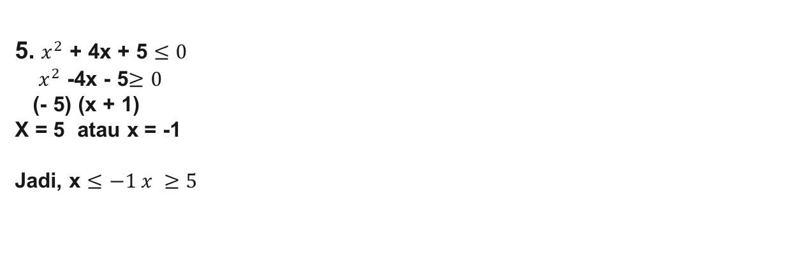
5. $x^{2}$ + 4x + 5 $≤0$ $x^{2}$ -4x - 5$≥0$ (- 5) (x + 1) X = 5 atau x = -1 Jadi, x $≤−1 x ≥5$
+++++ +++++
-1 0 5

Slide 19
selesai

